Slide 1


William Hunter Weekly Update: Week of 6/10
Financial Crimes Monitoring & Investigations Center
June 14th, 2019

Slide 2



Weekly Objectives
What did I hope to achieve?
Onboard and adapt to A&M
Research the Capabilities of D3
Start on the creation of Opportunity Hunter
June 14, 2019

Slide 3

Completion of Onboarding
Weekly Progress
Got Settled in Office
Moved into office, met the team, and got familiar with the work environment.
Connected to VPN
Connected with the Dallas office, so I can access their SQL servers.
Set up ATOM
Set up ATOM and Python on my computer, so I have a functioning Python IDE.
Learned Python
Learned the basics of Python learned proper technique and methodology.
June 14, 2019

Slide 4



Research on D3
Weekly Progress
Found example projects to learn the capabilities of the language
Learned basic JavaScript and jQuery Terminology
Explored the GitHub and learned of methods available
June 14, 2019

Slide 5

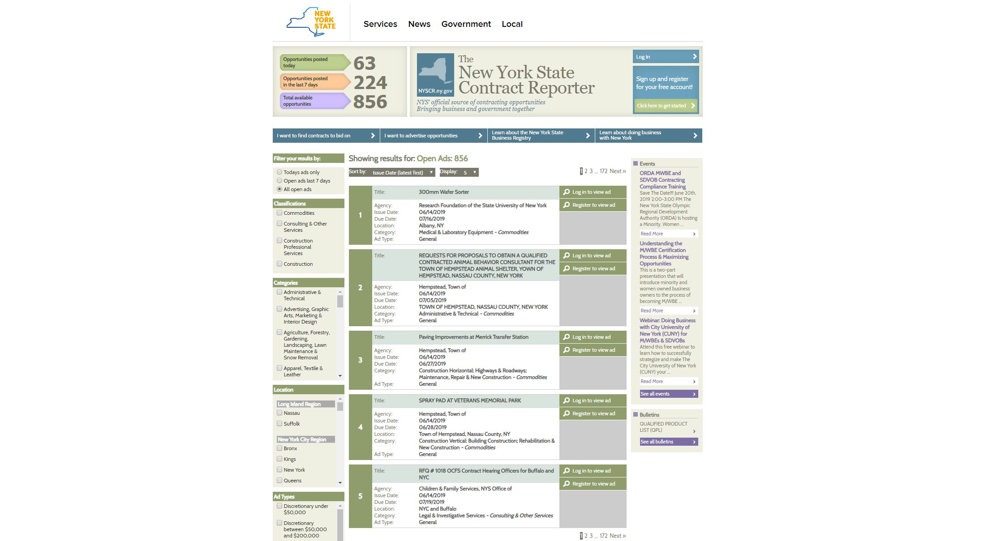
Creation of Opportunity Hunter
Weekly Progress
Researched basics of web scrapping
Identified sites to scrape
Successfully deconstructed how NYSCR was designed
Able to scrape information from one ad on NYSCR
Able to scrape information from all pages on NYSCR
All the information is stored in arrays
Cleaned and made comments on code
June 14, 2019

Slide 6



Challenges Encountered
Preliminary Difficulties with Opportunity Hunter
Scale
Scaling the python scraping algorithm to many websites will be very difficult, almost impossible to automate due to the variety of HTML Code of the websites.
Languages
Having to learn multiple new languages throughout these projects is very interesting, but slows down progress as I am constantly referring to Google for small details.
SQL
Connecting to the SQL server will be a challenging task, and will require a lot of time to complete due to my inexperience with remote servers.
June 14, 2019

Slide 7




Expected Next Steps
Progressing Opportunity Hunter
Store The Data
Figure out a way to store the collected data in a SQL server, preferably the Dallas SQL server.
Fixed Format
Create a standardized format for the data, that is universal for all of the websites we scrape.
Cleaning the Data
Clean the data that has already collected from NYSCR to fit fixed format, convert strings to integers.
Optimization
Further optimize the scraping algorithm. Implement a class system so that it can be scaled up.
June 14, 2019

